Slide 1
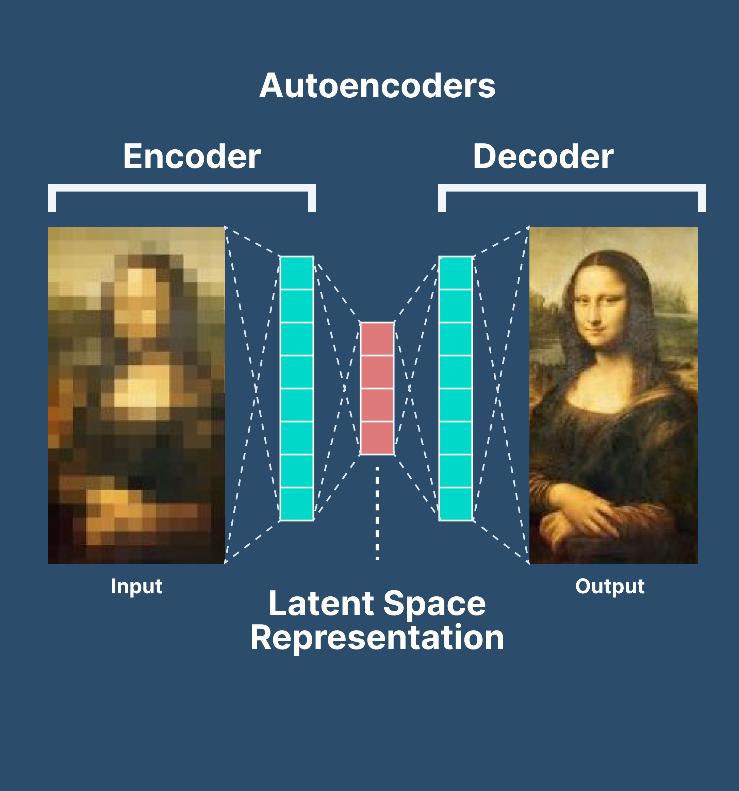
Autoencoders
Unsupervised learning
Representation learning
Uncover hidden features
Enhance interpretability
Aid in transfer learning
(building models that learn from new classes.

Slide 2
What is an Autoencoder
Create an architecture with a bottleneck, which ensures a lower-dimensional representation of the original data.
It is one of the technologies and techniques that enable computer systems to solve data compression problems more efficiently.
➔solution for reducing noisy data.

Slide 3
Autoencoders: The idea
Create an architecture with a bottleneck, which ensures a lower-dimensional representation (encoding) of the original data.

Slide 4
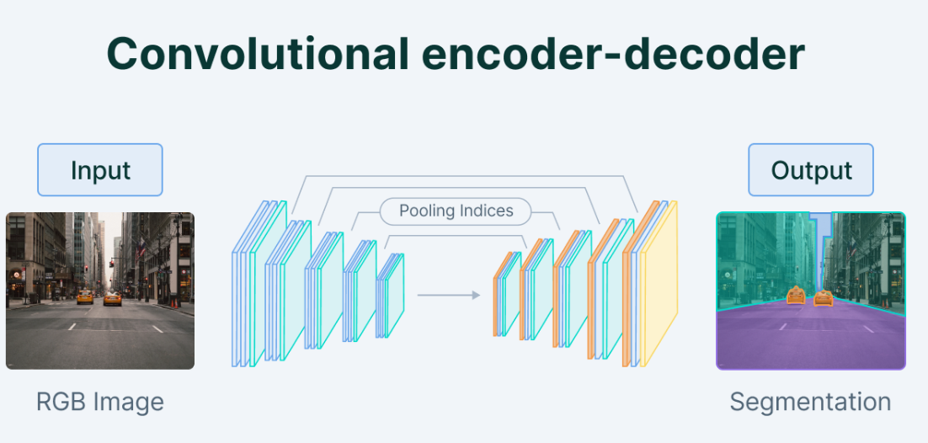
Reduce dimensionality ➔ Training the network to find patterns
Applications➔
Generation
Denoising
Anomaly detection
...

Slide 5
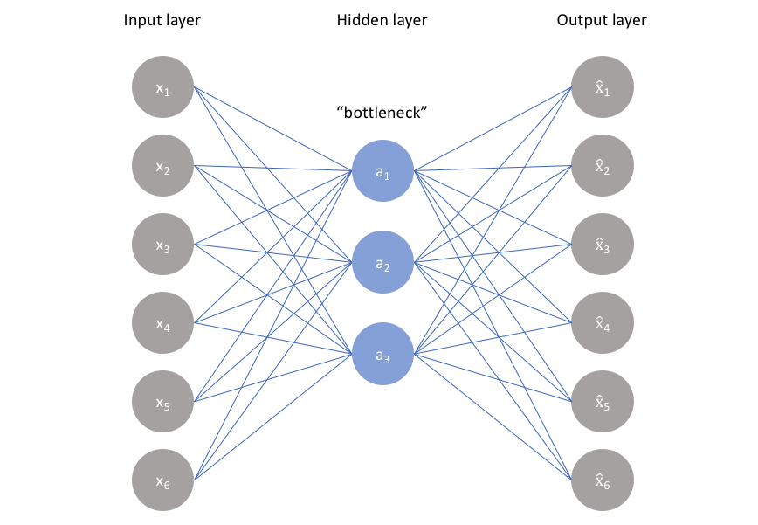
The latent space keeps the most important attributes of the input data
compressed knowledge
Compresses the train-validate-test set input data
Reconstructs the data back from its encoded form

Slide 6
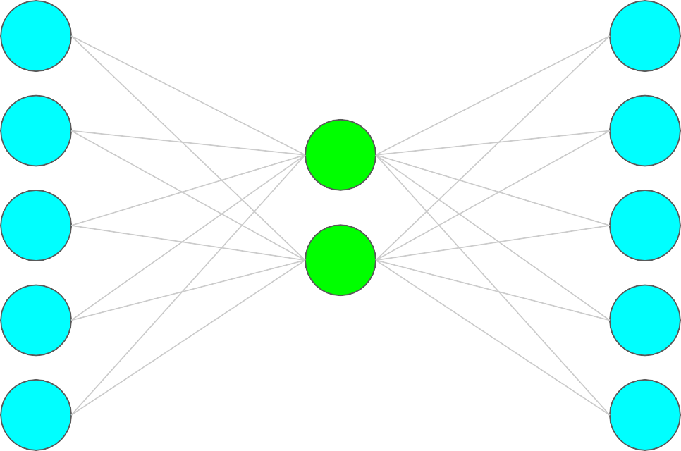
Input layer
CONDITION:
Data should have dependencies across dimensions
Output layer
x₁
x’₁
Output is expected to be the
same as the input data
with reduced noise.
Bottleneck
x₂
x’₂
v₁
x₃
x’₃
v₂
x₄
x’₄
Bottleneck
prevents the neural network from memorizing the input and overfitting on the data➔the smaller bottleneck the less overfitting
x₅
x’₅
Encoder = compress data into lower-dimensional representation
(latent space)

Slide 7
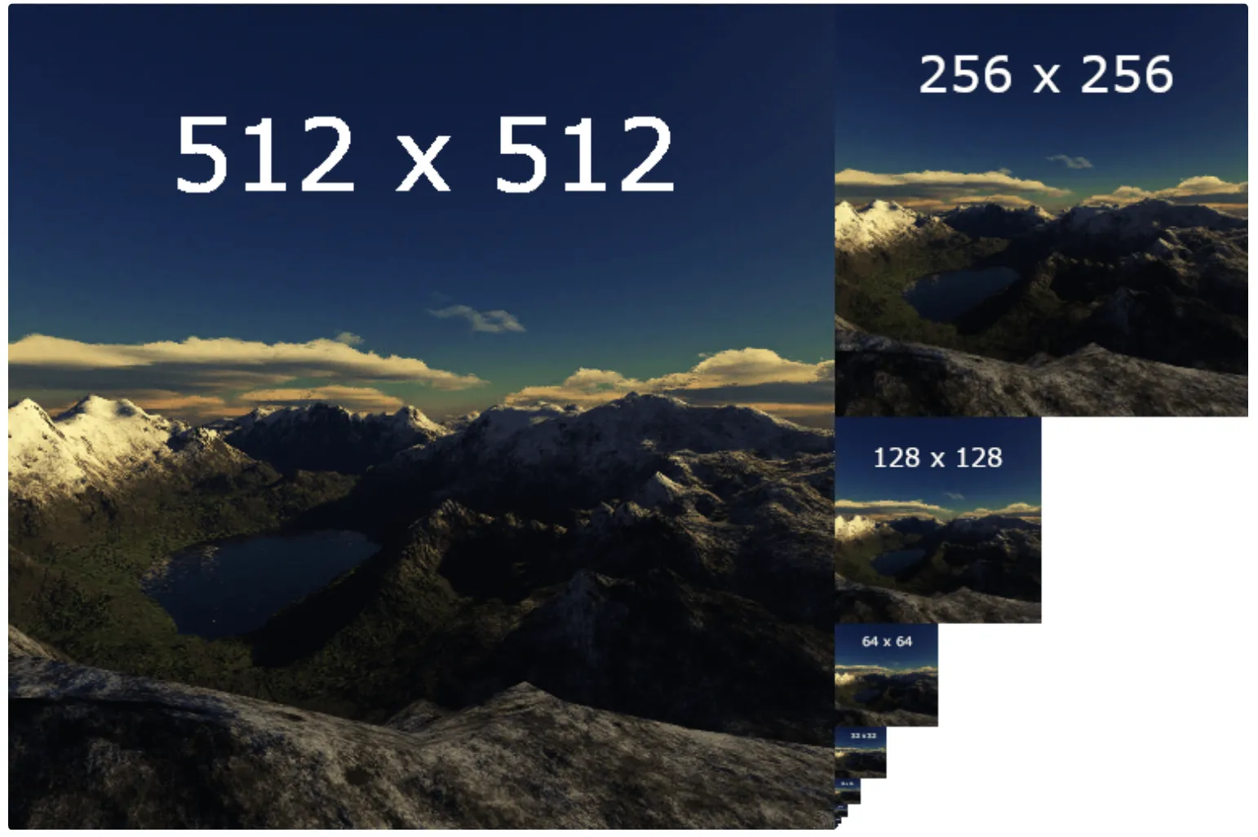
Downsampling

Slide 8
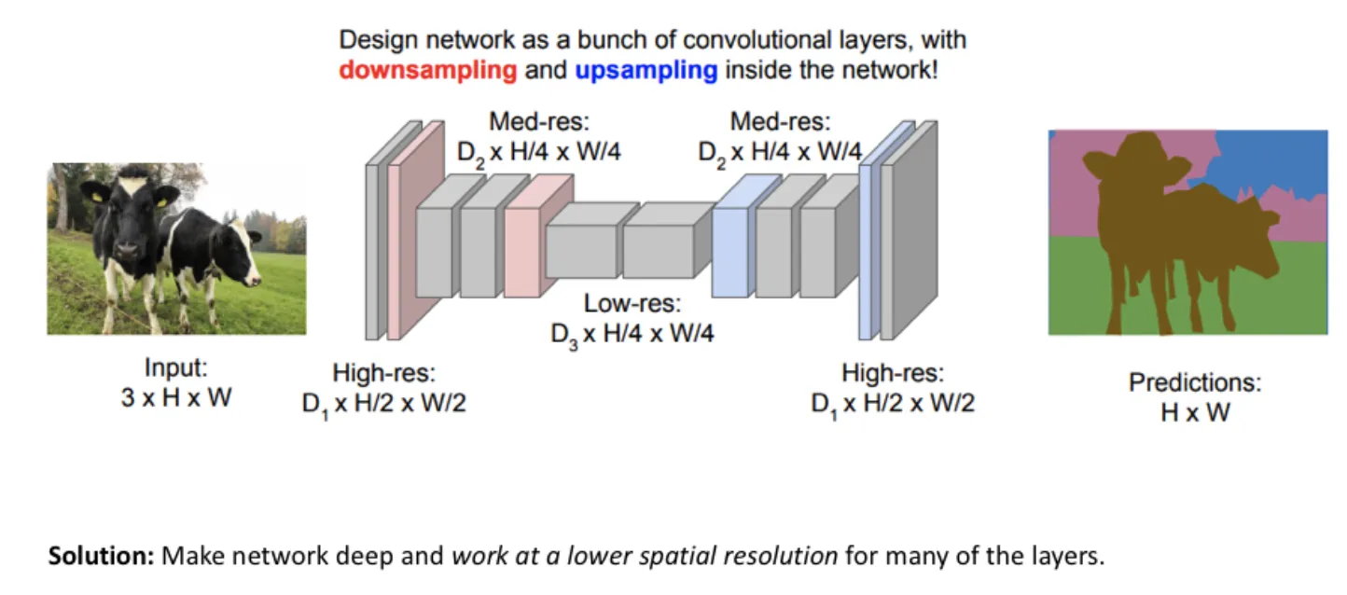
Up sampling

Slide 9
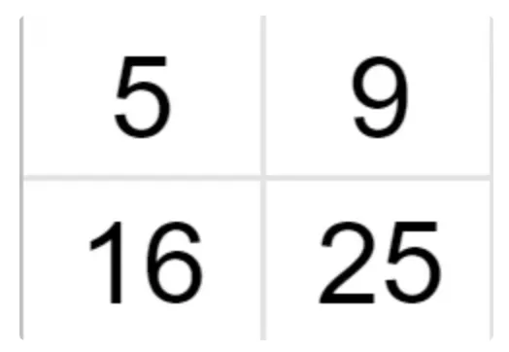
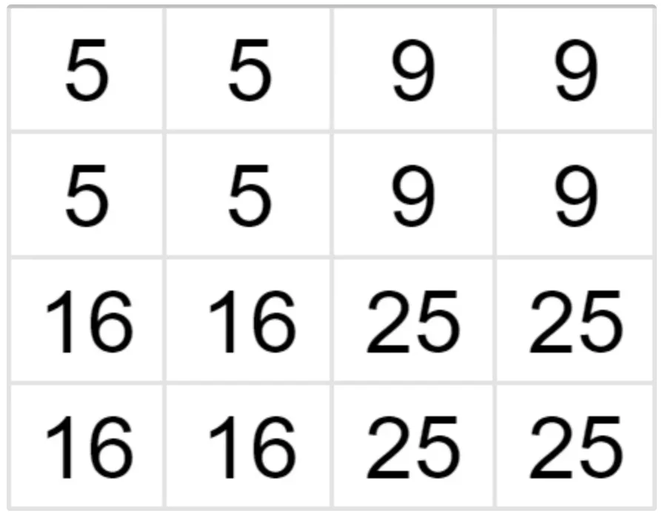
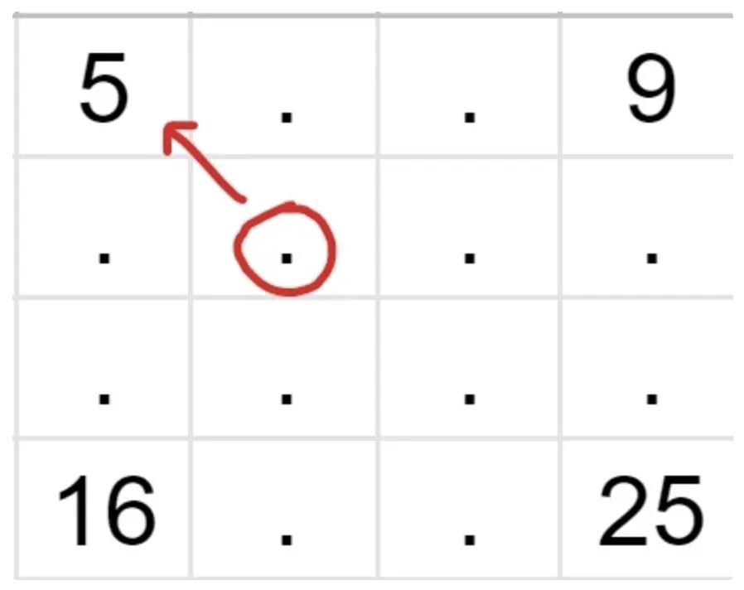
Up sampling by nearest neighbor interpolation

Slide 10
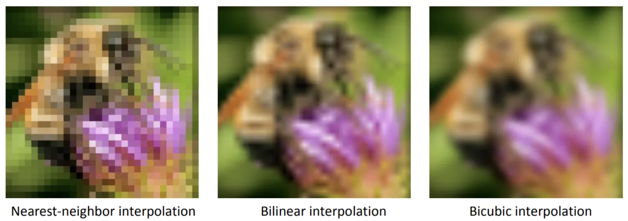
An image multiplied by a factor of 10 using different techniques (ordered by growing complexity).
Comparison of the upsampled images' resolution

Slide 11
Input layer
Output layer
x₁
x’₁
Bottleneck
x₂
x’₂
v₁
x₃
x’₃
v₂
x₄
x’₄
x₅
x’₅
Decoder = Decompress representation back to original domain

Slide 12
6 types of autoencoders
Undercomplete (unsupervised/simple) autoencoders
Sparse autoencoders
Contractive autoencoders
Denoising autoencoders
Variational Autoencoders (for generative modelling)
Deep Autoencoder

Slide 13
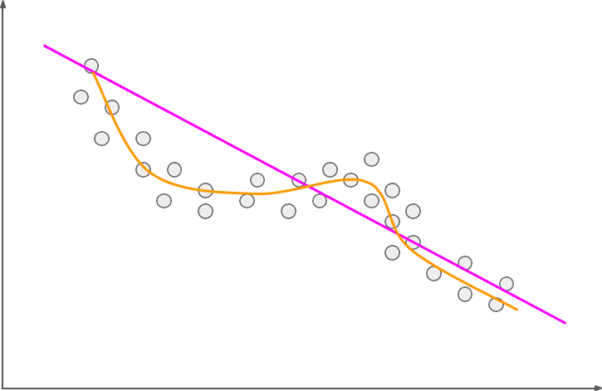
PCA vs Encoders
Both perform dimensionality reduction
PCA learns linear relationships
Encoders can learn non-linear relationships
Encoder = PCA, if it uses linear activation functions

Slide 14
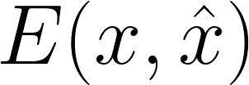
How can we train an autoencoder?
Backpropagation
Minimise reconstruction error
Original data
Reconstructed data

Slide 15
2. Sparse autoencoders
Sensitive enough to input data to reconstruct it
Insensitive enough to input data not to overfit it
The loss function
Sparse autoencoders work by penalizing the activation of some neurons in hidden layers (not on the size of the weights at the nodes)

Slide 16
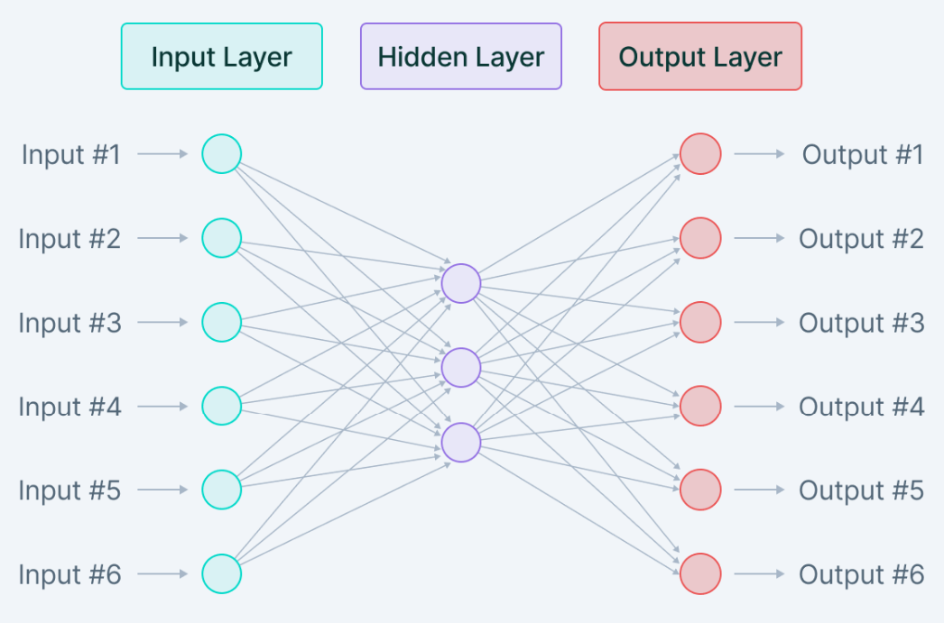

Where h represents the hidden layer, i represents the image in the minibatch, and a represents the activation

Slide 17
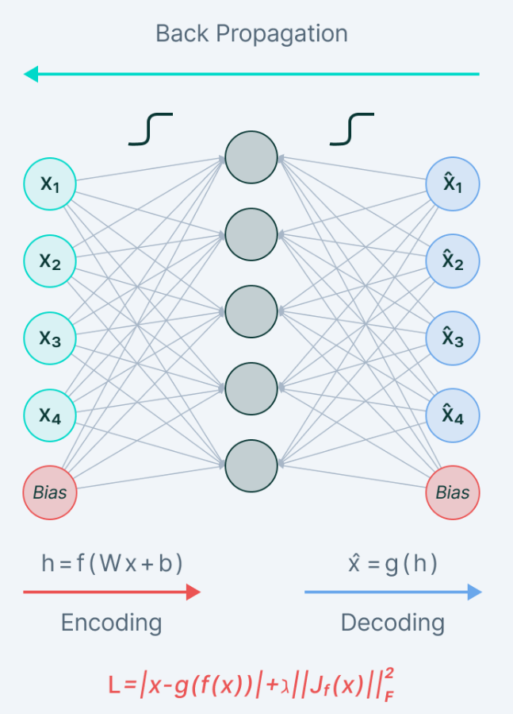
3. Contractive autoencoders
Latent space does not vary by a huge amount for minor variations in the input
Gradient is summed over all training samples

Slide 18
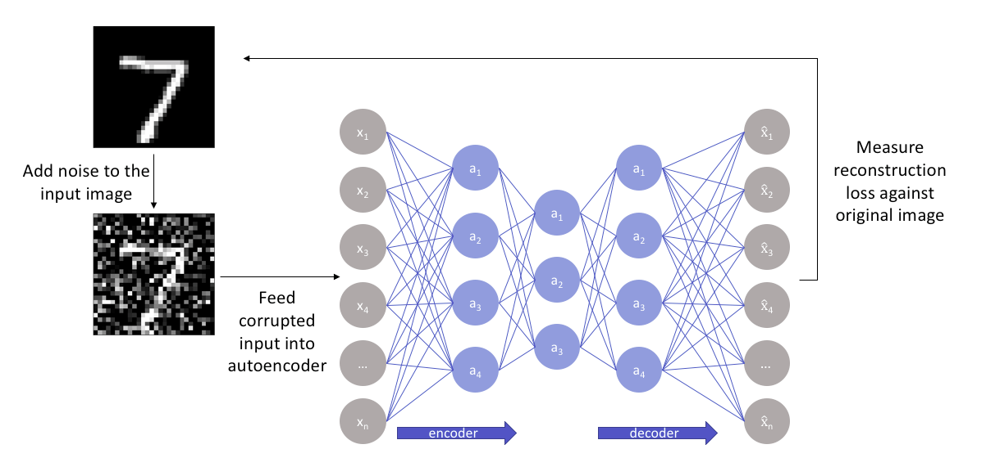
4. Denoising autoencoders
Non-linear dimensionality reduction.
The loss function is L2 or L1 summed over all training samples
Does not use the input as a ground truth

Slide 19
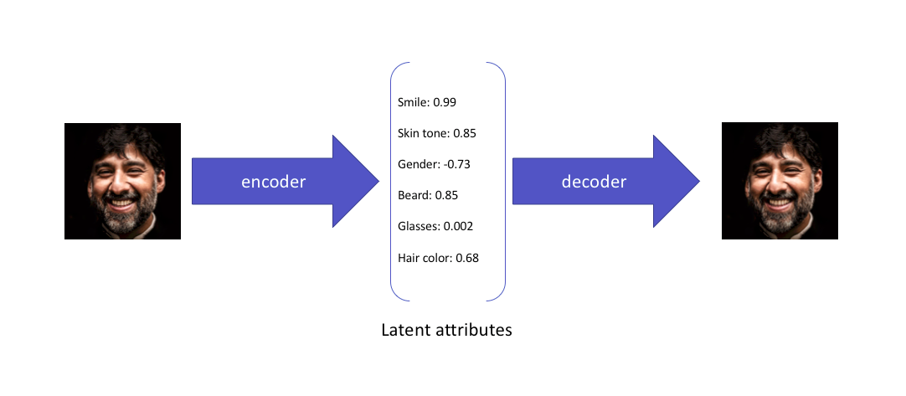
5. Variational autoencoders
Identify the characteristics of the latent vector z that reconstructs the output given a particular input➔ estimate parametrized distribution ➔minimize the KL divergence between the original distribution and our parameterized one.
bypass the sampling process from the neural network

Slide 20
Loss function: Variational Autoencoder
Kullback–Leibler Divergence
Reconstruction error
Penalize observations where mean and log variance vectors differ significantly from the parameters of a standard normal distribution (mean vector = 0 and log variance = 0)
Difference between normal distribution (mean vector, log variance vector) from standard normal distribution

Slide 21
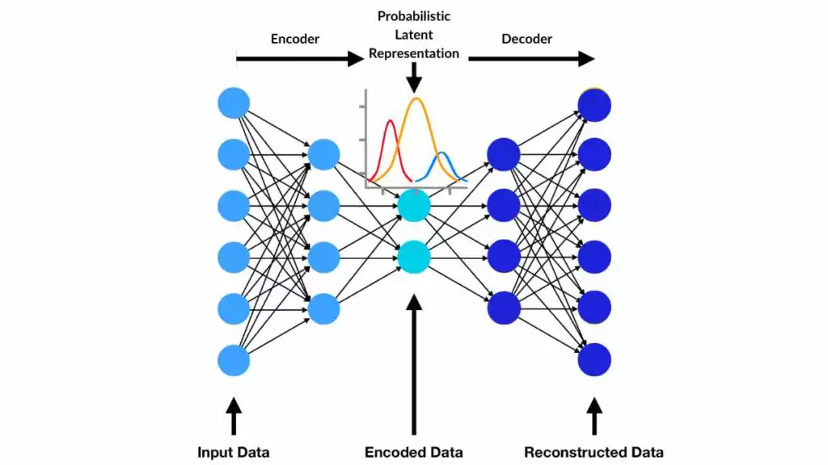
The addition of the KL divergence term ensures that the learned distribution is close to a prior distribution, which is essential for generating diverse and meaningful samples.

Slide 22
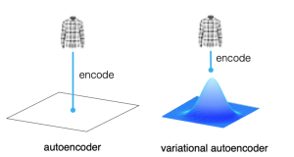
Generative AI models, autoencoders (AE) and variational autoencoders (VAEs) have emerged as powerful unsupervised learning techniques for data representation, compression, and generation

Slide 23
6-Deep Autoencoder
v₁
v₂

Slide 24
6-Deep Convolutional Autoencoder (CAE)
Similar architecture to AE
Convolutional layers
Encoder: Convolution + Leaky Relu +Batch normalization
Decoder: Convolution transpose + Leaky Relu + Batch normalization

Slide 25
Deep Autoencoder Advantages
Image denoising: CAEs can filter out noise and redundant information from images.
Dimensionality reduction: CAEs can compress high-dimensional images into a lower-dimensional representation.
Image generation: CAEs can reconstruct images from a lower-dimensional representation.
Defect detection: CAEs can be used to detect defects in artworks by enhancing thermal images and extracting features.
Subsurface flow property distribution: CAEs can be used to parameterize complex subsurface flow property distributions.
ECG denoising and classification: CAEs can be used to denoise and classify electrocardiogram (ECG) signals.
CAEs are powerful tools that can be applied in many industries, including healthcare, anomaly detection, information retrieval, and recommendation systems

Slide 26
Generation with AEs
x₁
x’₁
x₂
x’₂
x₃
x’₃
x₄
x’₄
x₅
x’₅

Slide 27

Generation with AEs
x₁
x’₁
x₂
x’₂
x₃
x’₃
x₄
x’₄
x₅
x’₅

Slide 28
Generation with AEs
x₁
x’₁
x₂
x’₂
x₃
x’₃
x₄
x’₄
x₅
x’₅

Slide 29
Generation with AEs
x₁
x’₁
x₂
x’₂
x₃
x’₃
x₄
x’₄
x₅
x’₅

Slide 30
Generation with AEs
x₁
x’₁
x₂
x’₂
x₃
x’₃
x₄
x’₄
x₅
x’₅

Slide 31
Generation with AEs
x₁
x’₁
x₂
x’₂
x₃
x’₃
x₄
x’₄
x₅
x’₅

Slide 32
Generation with AEs
x₁
x’₁
x₂
x’₂
x₃
x’₃
x₄
x’₄
x₅
x’₅

Slide 33
Generation with AEs
x₁
x’₁
x₂
x’₂
x₃
x’₃
x₄
x’₄
x₅
x’₅

Slide 34
Generation with AEs
x’₁
x’₂
x’₃
x’₄
x’₅

Slide 35
Generation with AEs
x’₁
Sample a point in the latent space and pass it through the decoder
x’₂
x’₃
x’₄
x’₅

Slide 36
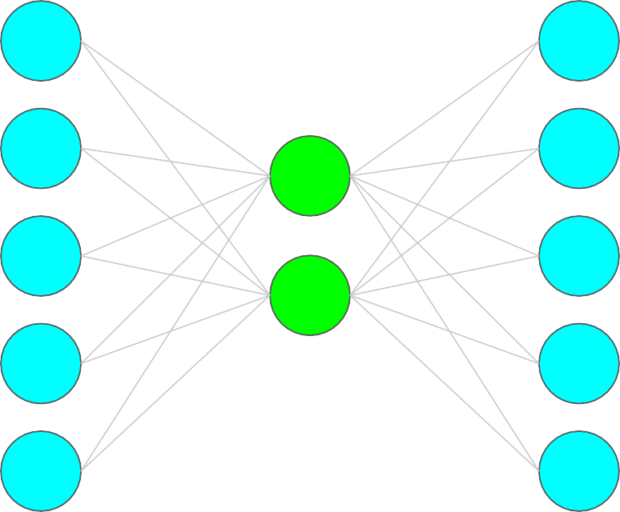
Denoising with AEs
x₁
x’₁
x₂
x’₂
v₁
x₃
x’₃
v₂
x₄
x’₄
x₅
x’₅

Slide 37
Denoising with AEs
x₁
x’₁
x₂
x’₂
v₁
x₃
x’₃
v₂
x₄
x’₄
x₅
x’₅

Slide 38
Denoising with AEs
x₁
x’₁
Add noise to audio
x₂
x’₂
v₁
x₃
x’₃
v₂
x₄
x’₄
x₅
x’₅

Slide 39
Denoising with AEs
x₁
x’₁
Add noise to audio
x₂
x’₂
v₁
x₃
x’₃
v₂
x₄
x’₄
x₅
x’₅

Slide 40
Denoising with AEs
x₁
x’₁
Add noise to audio
x₂
x’₂
v₁
x₃
x’₃
v₂
x₄
x’₄
x₅
x’₅

Slide 41
Denoising with AEs
Measure reconstruction error of output against original audio
x
1
x’
1
Add noise to audio
x₂
x’₂
v₁
x₃
x’₃
v₂
x₄
x’₄
x₅
x’₅

Slide 42
Autoencoder doesn’t see the clean image as input — it learns to restore it.
Stage | Input | Output | Description
Encoder | Noisy image (784 features) | Compressed features (32) | Learns noise-robust representations
Decoder | Encoded representation | Denoised image | Learns to reconstruct clean image
Loss Function | Binary Crossentropy | Measures how close reconstruction is to clean input

Slide 43
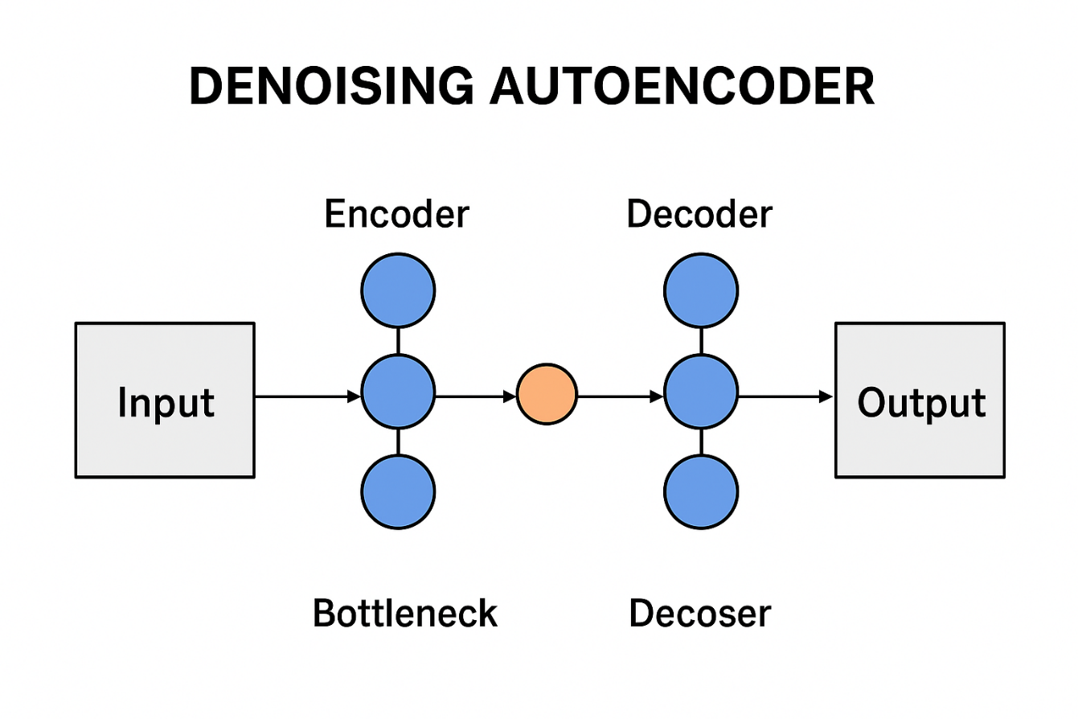

Slide 44
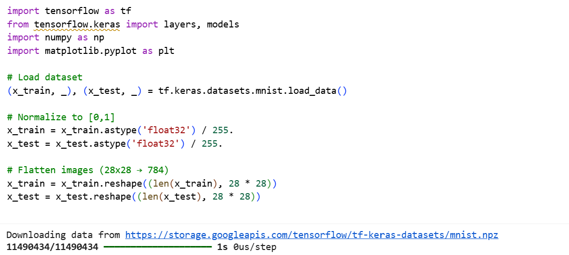

Slide 45
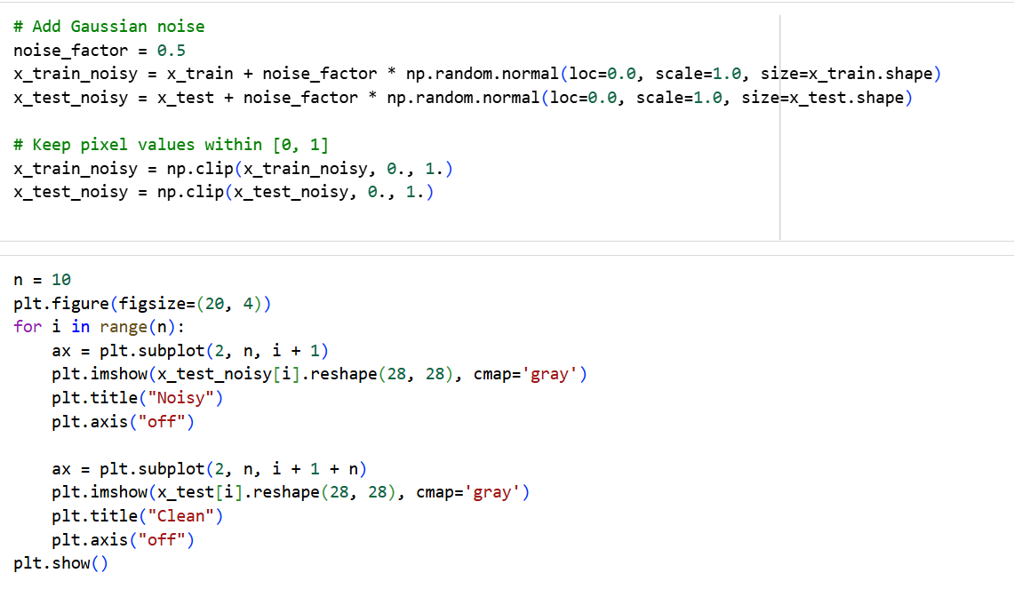

Slide 46
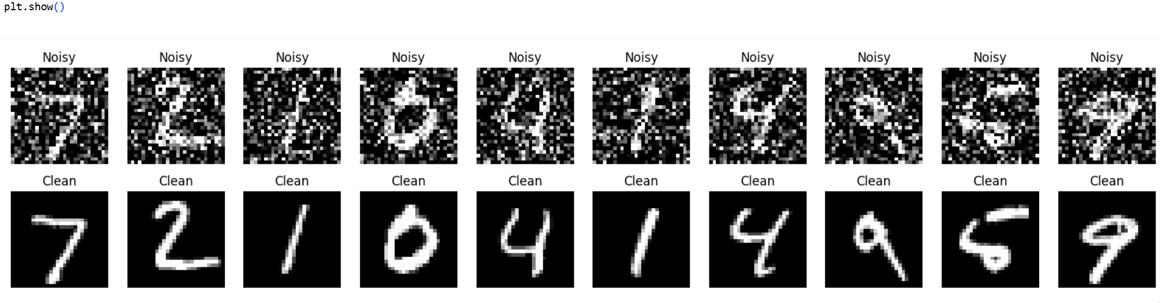

Slide 47
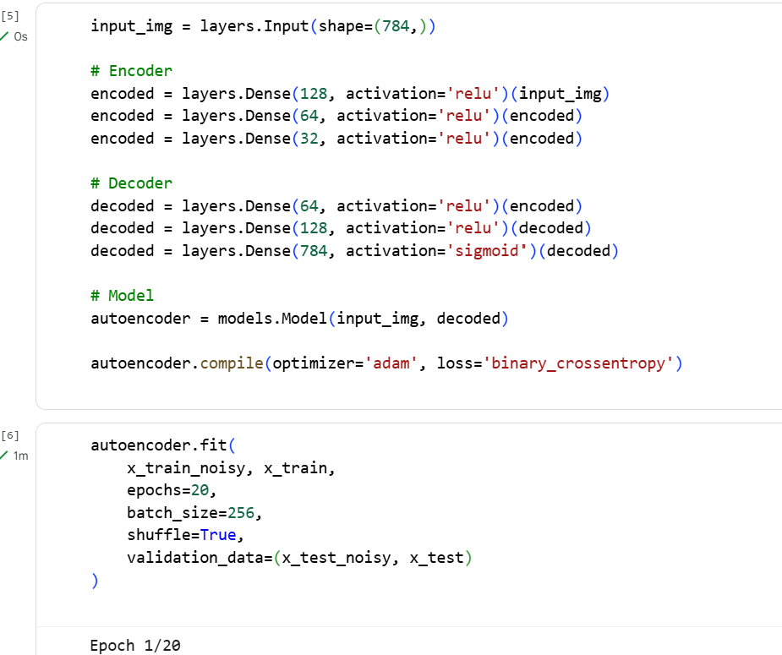

Slide 48
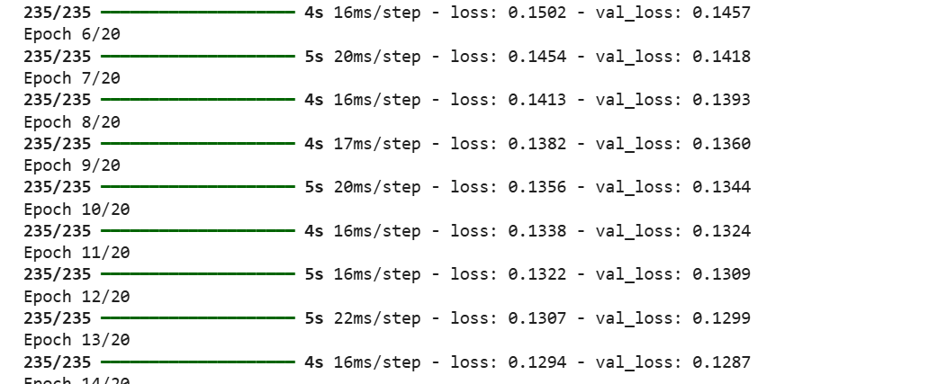

Slide 49
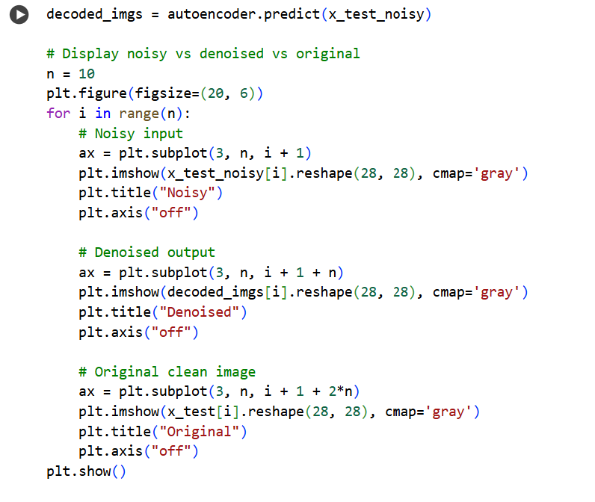

Slide 50
